Slide 1



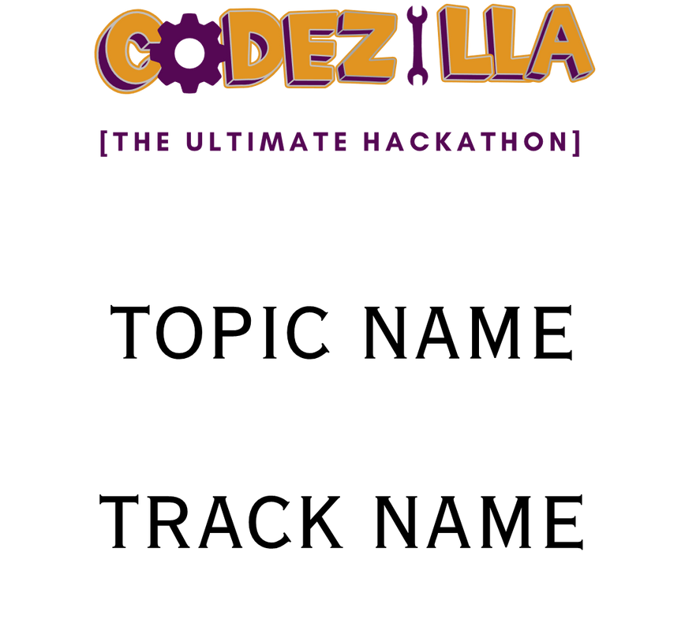
Verbwire : Blockchain Risk Management

Slide 2

TEAM DETAILS
Roshan Patil : roshan.patil24@mmit.edu.in
Aniket Khobare : aniket.khobare24@mmit.edu.in

Slide 3
PROBLEM STATEMENT
Blockchain Risk Management: Build a blockchain system for BFSI (Banking, Financial Services, and Insurance) to track financial transactions, prevent fraud, and automate processes like claim settlements and loan disbursements using smart contracts. Ensure regulatory compliance and provide real-time dashboards for monitoring and role-based access.

Slide 4

TECH STACK
Frontend
HTML & CSS: For structuring and styling the user interface.
Bootstrap: For responsive and visually appealing design.
JavaScript: To add interactivity and dynamic behavior.
Backend
PHP: For server-side logic and handling user requests.
MySQL: For database management to store user and health data.
Blockchain Integration
Verbwire API: For integrating blockchain to ensure secure, tamper-proof storage of sensitive health data.
Development Tools
phpMyAdmin: For managing the MySQL database.
XAMPP: For creating a local server environment.
VS Code: For efficient coding and debugging.

Slide 5
Proposed Solution
01
Utilize blockchain for secure, immutable records.
02
Transparent tracking of loans, claims, and approvals.
03
Integration with a relational database for efficient data management.
04
Enhanced user trust through decentralization.

Slide 6


Features
Loan Management:
Apply for loans with document uploads.
Transparent status tracking
Claims Processing:
Submit claims with supporting documents.
Automated status updates.
Blockchain Integration:
Ensures data integrity and trust.
User Accounts: Secure registration and login.

Slide 7
Workflow
Step 1: User registers and logs in.
Step 2: User applies for loans or submits claims.
Step 3: Data is stored in MySQL and verified via blockchain.
Step 4: Admin reviews and updates statuses.
Step 5: Blockchain ensures immutable records.
Benefits of Our Solution
Security: Blockchain ensures tamper-proof records.
Transparency: Users can track their applications in real-time.
Efficiency: Automated workflows reduce processing time.
Scalability: Can handle increasing user data with ease.

Slide 8
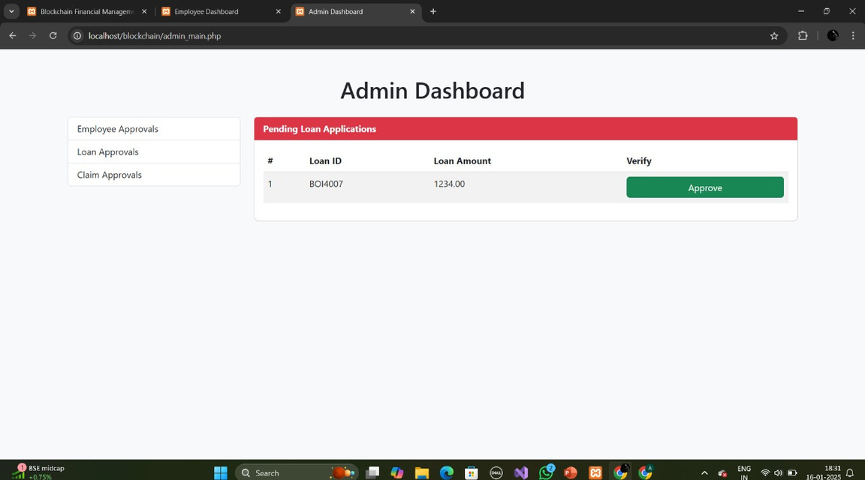
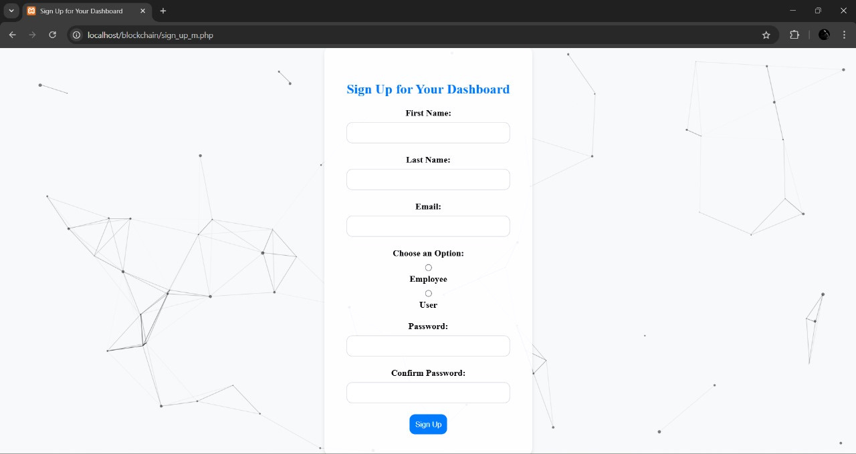
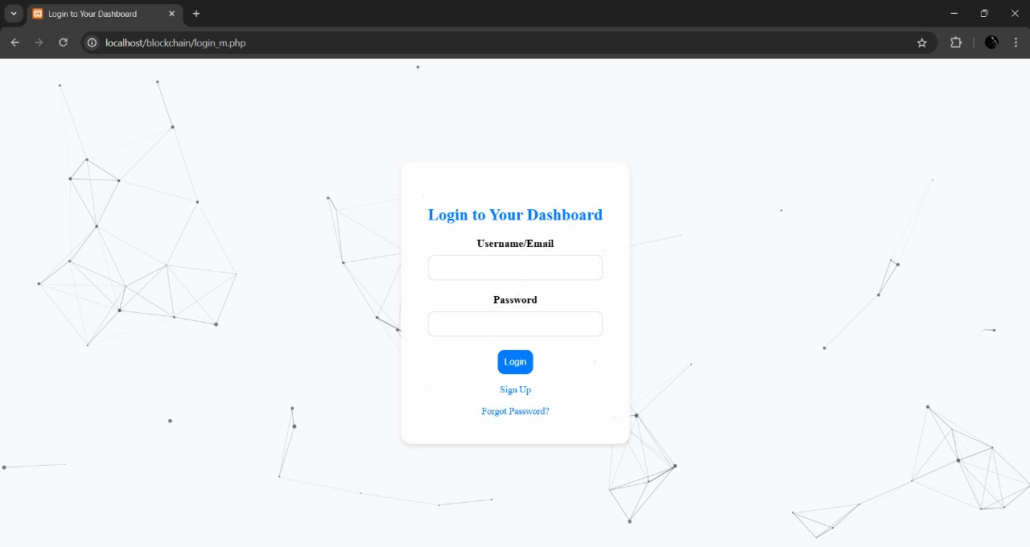
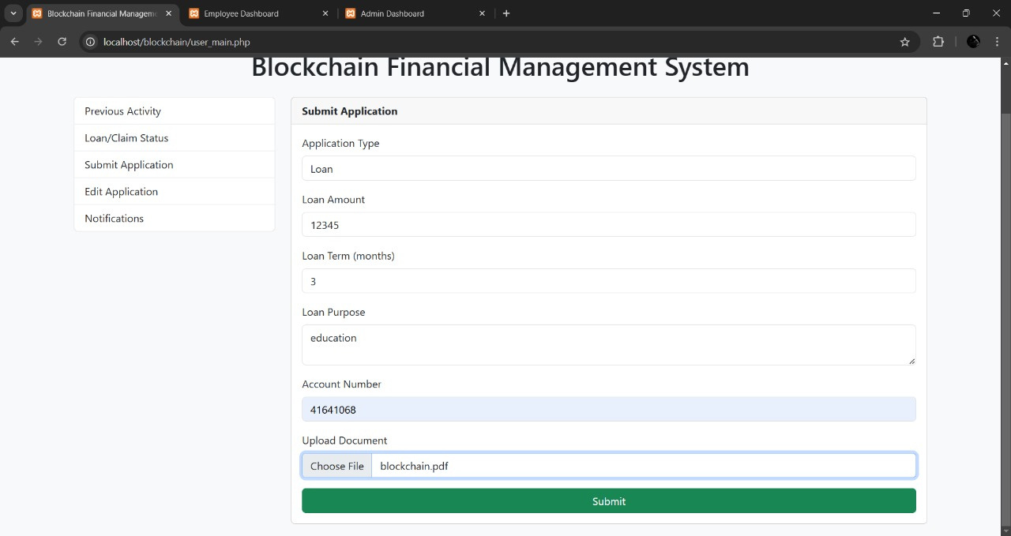
System Screenshots

Slide 9
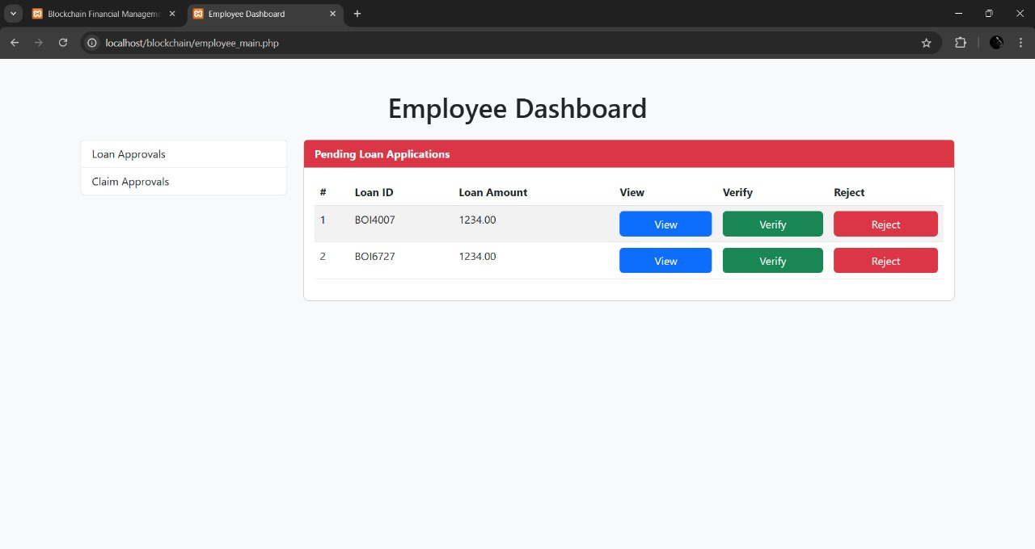
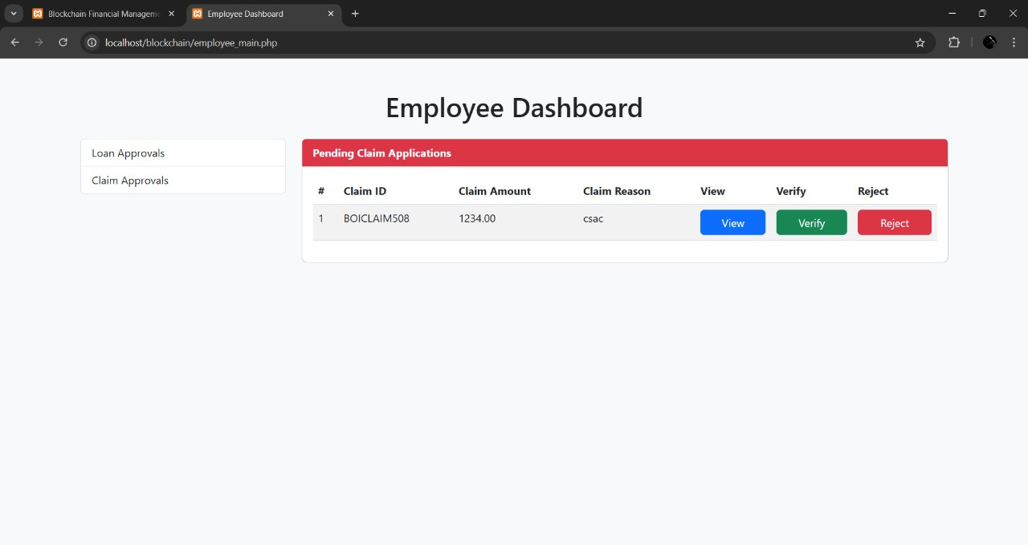
System Screenshots

Slide 10
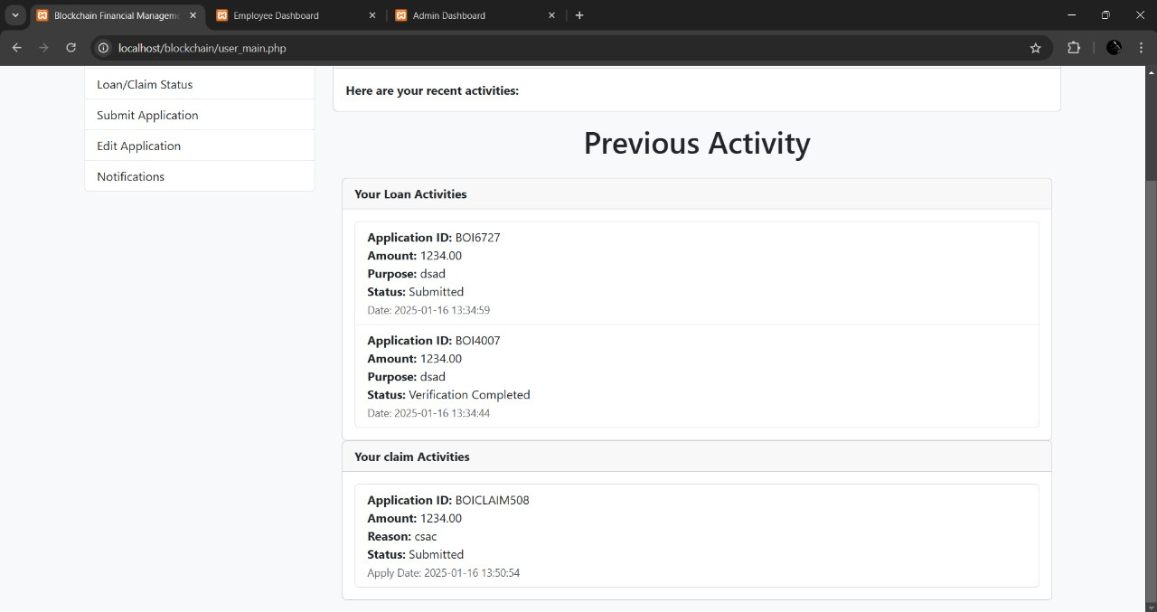
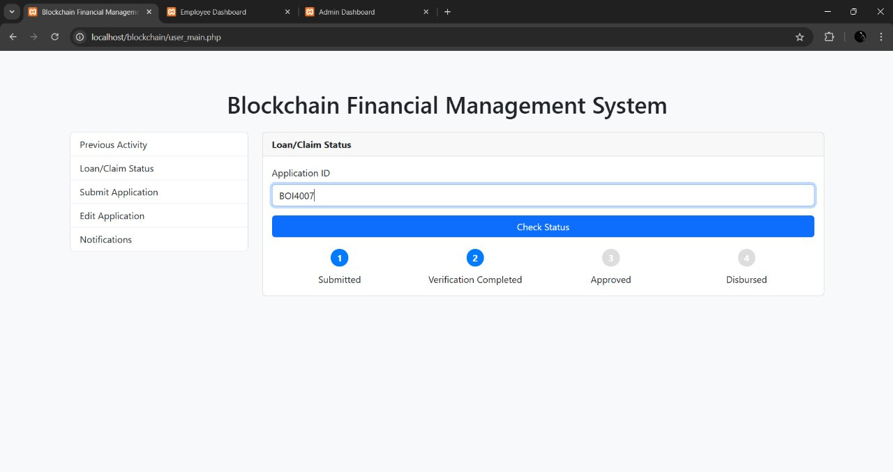
System Screenshots

Slide 11
Future Scope
|
Integration with AI for Enhanced Security:
Use AI-driven algorithms to detect fraudulent activities and enhance the security of blockchain transactions.
||
Expansion to Decentralized Finance (DeFi):
Enable smart contracts and DeFi applications to provide transparent and automated financial services.
|||
Cross-Border Financial Solutions:
Facilitate seamless, secure, and low-cost international transactions using blockchain technology.

Slide 12
Thank You...!

